Slide 1
Developing Software for Law Enforcement
Dr Joseph Williams
University of Hertfordshire
j.williams30@herts.ac.uk
&
Dr Paul Stephens
Canterbury Christ Church University
paul.stephens@canterbury.ac.uk | https://www.linkedin.com/in/paulstep/

Slide 2
The Problem – Requirement for a Bespoke Tool

Slide 3
Exploration of the problem
A real mishmash of software
From free browser add-ons to expensive suites
The tools used were sometimes great, but were shoehorned into the role
The utter misery of using a spreadsheet to log every single website visited
Hashing every single file you download
Officers and civilian staff required to conduct open source research on the Internet
Pretty much every officer will conduct ‘open source research’
From Professional Standards Department (PSD), anti-terrorism units to vetting

Slide 4
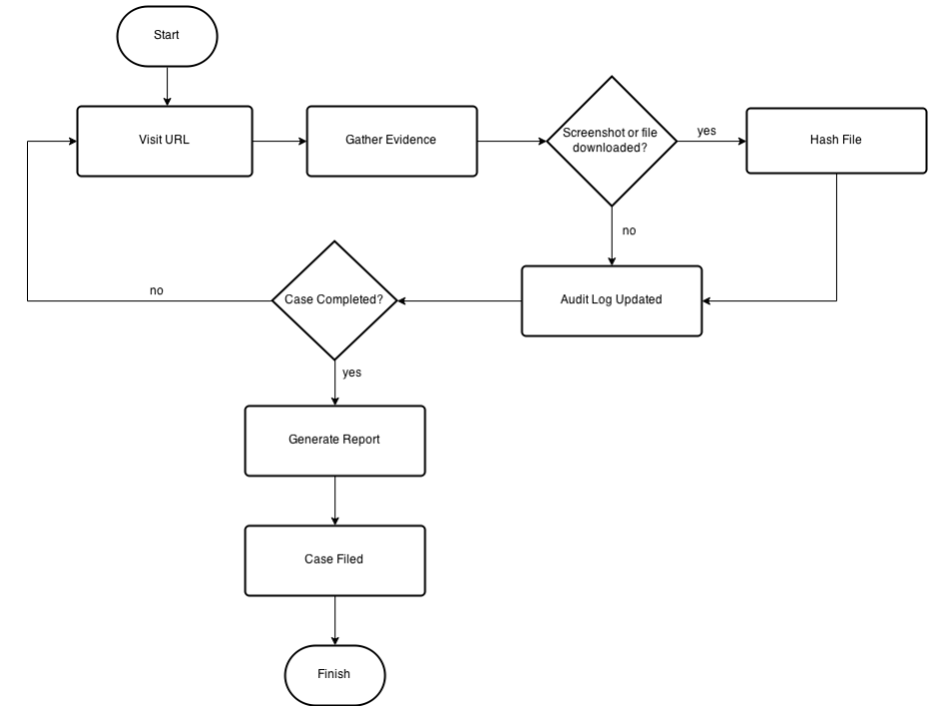

Slide 5
What was needed
Officers and civilian staff are required to conduct open source research on the Internet
College of Policing requested a bespoke tool to relieve some of the tedium
One that ‘just does it’
Case creation
Evidence gathering
Logging
Screen capturing (dynamic and static)
Hashing
Report generation
Saving and reloading cases

Slide 6
The legal, ethical and procedural issues

Slide 7
Methodology for Open Source Research
Bucknor v R [2010]EWCA Crim 1152
Any material taken from the Internet must have full provenance
i.e., The ability to record the history of data and its place of origin
ACPO – Good Practice Guide for Computer-Based Electronic Evidence
Particularly principle 3, the need for an audit trail
ACPO Guidelines were intended for traditional ‘dead box’ computer forensics
Given the nature of the way the Internet stores its data, these guidelines do look dated
Principle 3 (the audit trail) is the principle closely followed by OSINT gatherers

Slide 8
The Dream
Social media is now significantly relevant to security and public safety
Facebook, for example, has been used to coordinate contract killings, boast about serious animal abuse, conduct cyber-stalking, plan sexual assaults, breach court orders and cause distress through anti-social ‘trolling’
Go to Twitter and get all the Tweets with this hashtag
Go to YouTube and download all the videos on this channel
Go to this person’s Facebook page and take a screenshot of their entire wall and his friends’ walls
However, we start delving into covert and the boundaries of “open source” are skewed

Slide 9
Laws
Regulation of Investigatory Powers Act (RIPA)
Open source, unlikely to require a RIPA authorisation
Data Protection Act/GDPR
Building a profile on a person or group must be necessary and proportionate
The Human Rights Act (Article 8)
Right to Respect for Private and Family Life
Building a profile on a person or group must be necessary and proportionate, to ensure that any resultant interference with a person’s Article 8 right to respect for their private and family life is lawful

Slide 10
Terms and Conditions
YouTube forbid the downloading of videos
Facebook forbid fake/impersonation accounts

Slide 11
The Prototype
Allowed for some course testing with people who did the job
Early on decision to be free and open source software

Slide 12
The redevelopment

Slide 13
OSIRT – Open Source Internet Research Toolkit
“A browser on steroids”
http://osirtbrowser.com

Slide 14
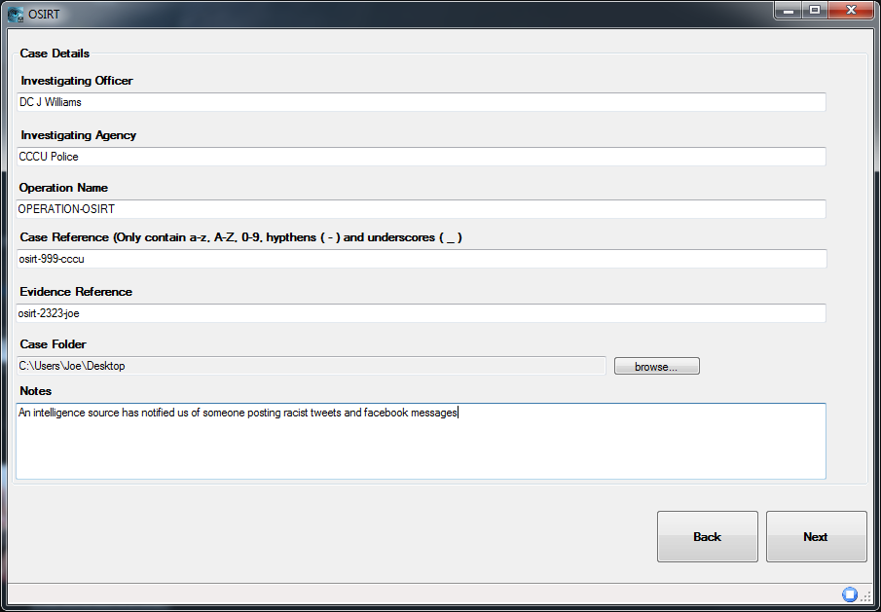
Case Creation

Slide 15
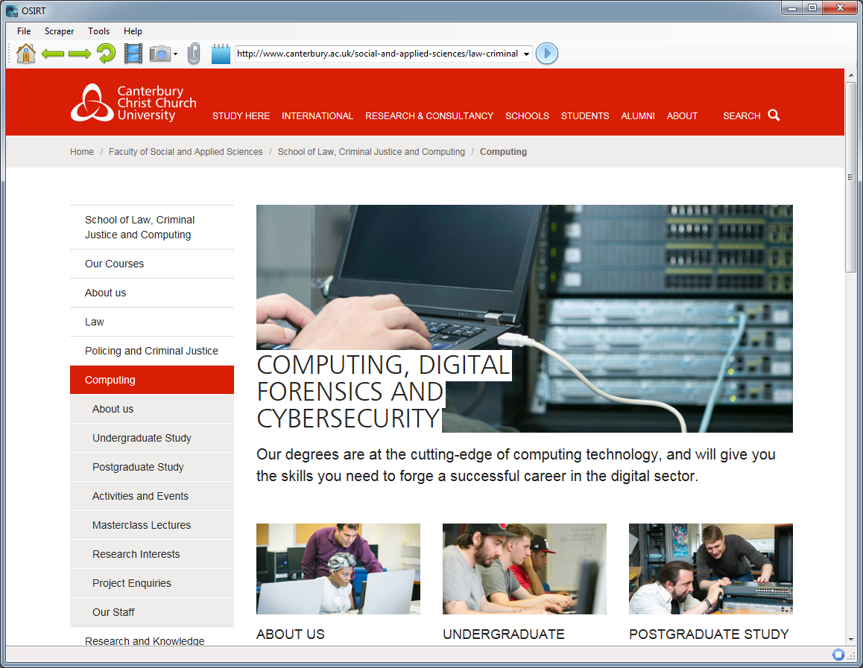
Browsing

Slide 16
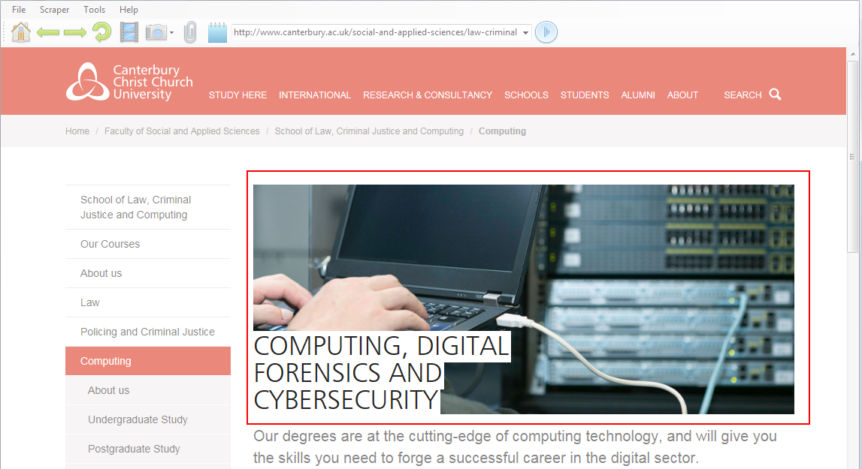
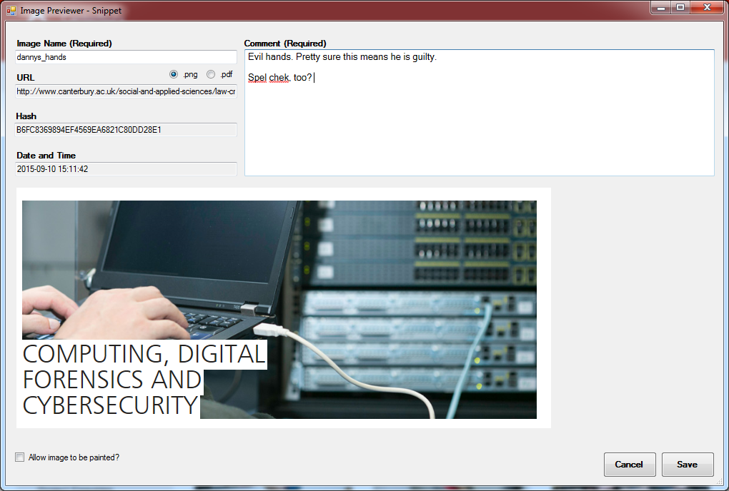
Static Screen Captures

Slide 17
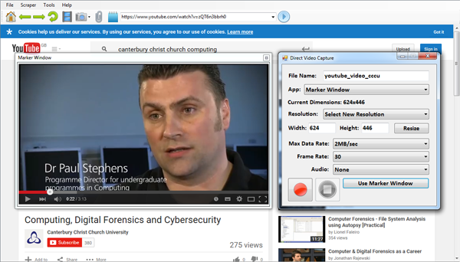
Dynamic Screen Captures
Video capture library by Matthew Fisher

Slide 18
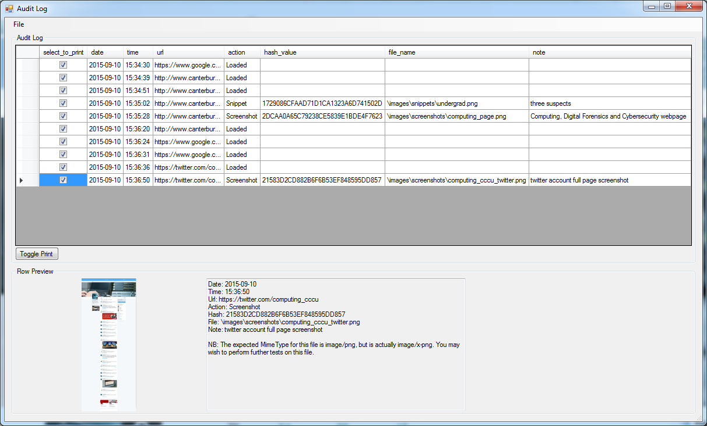
Audit Log

Slide 19
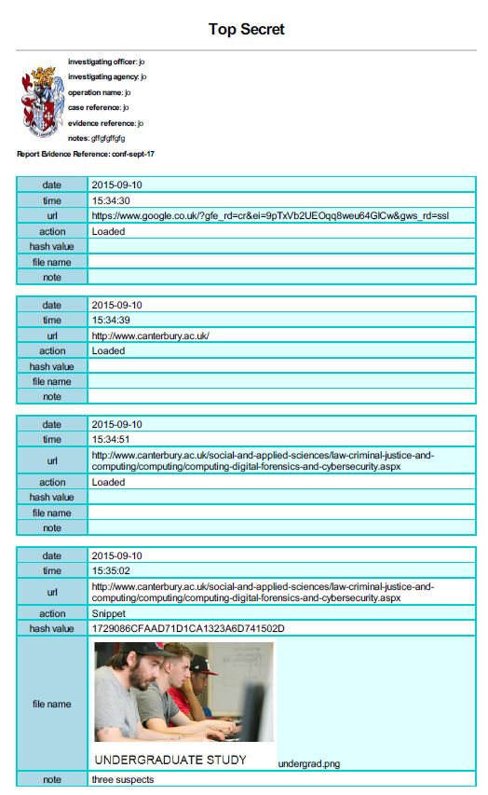
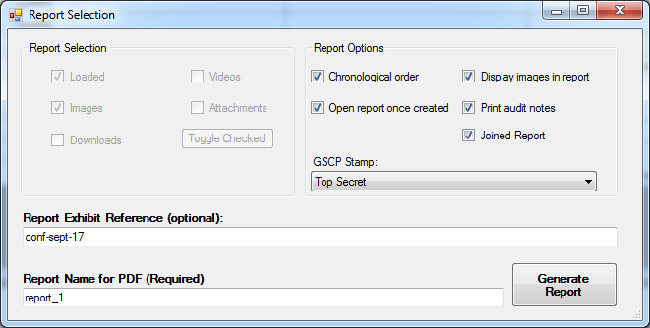
Report Generation

Slide 20
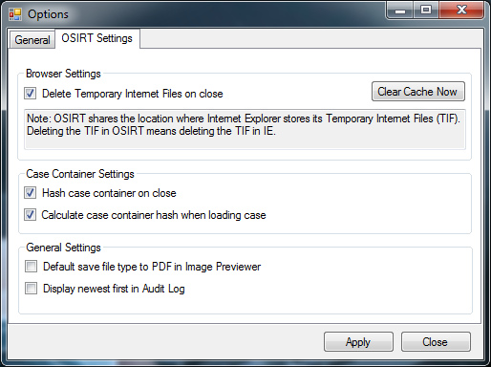
Options

Slide 21
The testing and feedback
Use in training
Questionnaires
Interviews
Emails
Additions based on feedback

Slide 22
The impact

Slide 23
Automation
Automatically logging saves time
“It’s at least halved, probably more actually, how long it takes me to conduct [open source] research” – DC from Staffordshire Police
More automation means
Time saved
Human error reduction

Slide 24
Already in Use
Used by LEO country wide (that we are aware of)
Dorset
Staffordshire
Leicestershire
Durham
Thames Valley
City of London
Met
Yorkshire
North Wales
Royal Air Force Police (Specialist drugs squad)
NCA

Slide 25
The Importance of Trust
Relationship with CoP
Access to police officers for exploration of the problem (sometimes in unexpected ways, e.g., ethical, legal and procedural issues)
Free and open source software
Embedding in CoP training – facilitating uptake, testing, evangelists and audience feedback
Trust built on the courses and by knowing the developer meant more able to judge impact

Slide 26
Discussion, Ideas and Questions?
j.williams30@herts.ac.uk
paul.stephens@canterbury.ac.uk

